Slide 1

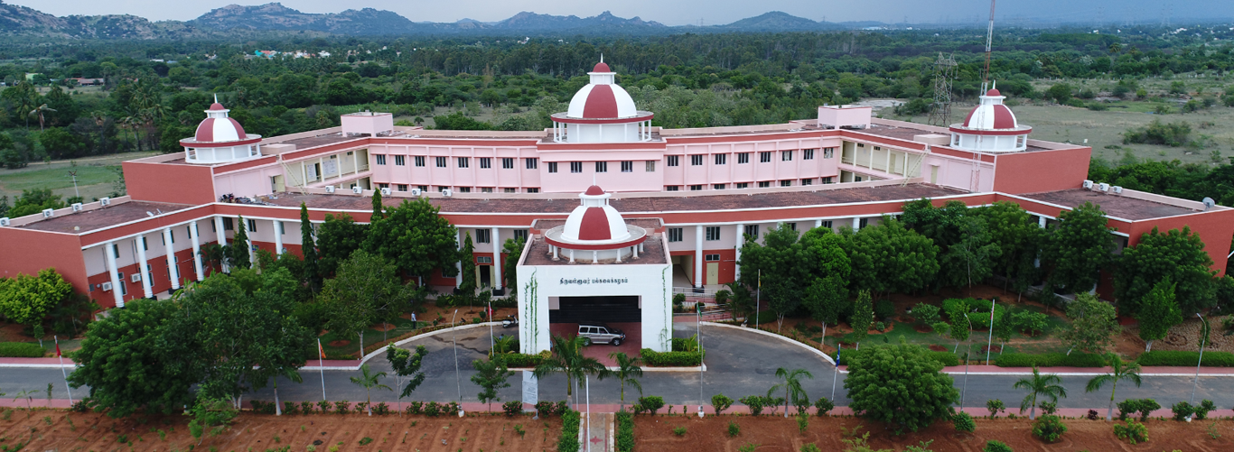
Microbial Diversity in Crude oil Reservoir
- AN OVERVIEW
By
Dr. A. Rajasekar
Assistant Professor &
DBT-Ramalingaswami Fellow,
Department of Biotechnology
Thiruvalluvar University,
Vellore, India

Slide 2
Core Research activities at EMMR Lab
Microbially-induced corrosion (MIC) in Crude Oil Well / Cooling tower system and Biodegradation of hydrocarbon
Remediation of hexavalent chromium/ zinc contaminated sites employing acidophilic microorganisms using an integrated approach of Bioleaching enhanced Electrokinetic remediation (BEER) Technology
Role of Bacterial Biosurfactant on remediation of environmental pollutants
Treatment of soak liquor and bioelectricity generation in dual chamber microbial fuel cell

Slide 3
Introduction
Microbiologically influenced corrosion (MIC) is an electrochemical process where microbes initiate, assist, or accelerate the corrosion reaction on the metal surface and lead to the metal deterioration (Rajasekar et al. 2005; Machuca et al. 2014).
Macro/microscopic organisms influence corrosion in two principal ways:
1. Creating mats (biofilm) or obstructions on the surface, which produce differential aeration cells.
2. Absorbing hydrogen from the surface of steel and thus removing the hydrogen as a resistance factor in the corrosion cell.
Corrosion reaction can be represented by partial reactions of metal oxidation and reduction process.

Slide 4
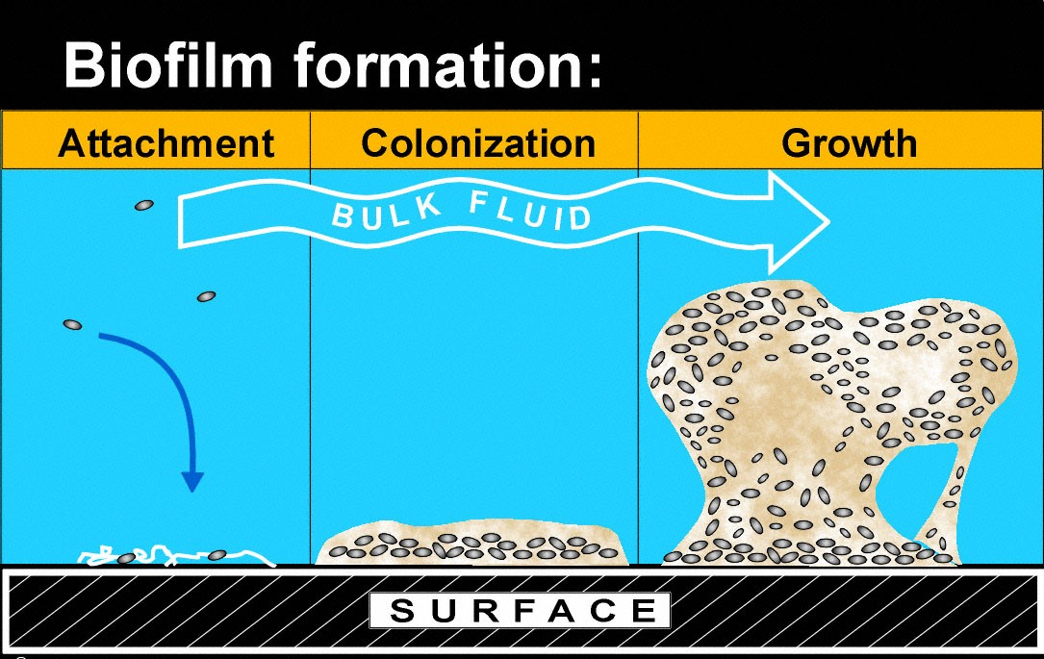
Biofilm
The instant a metallic surface is immersed in water, a biofilm begins to form. A consortium of sessile organism enveloped in exopolymer.
Development of a biofilm occurs in four stages
Conditioning
Adhesion
Colonization of other microorganism
Accumulation

